Slide 1
Mokum Airways
BA2018
Daphne Molenwijk, Laura Holt, Wouter den Duijn, Joyce Timmer

Slide 2
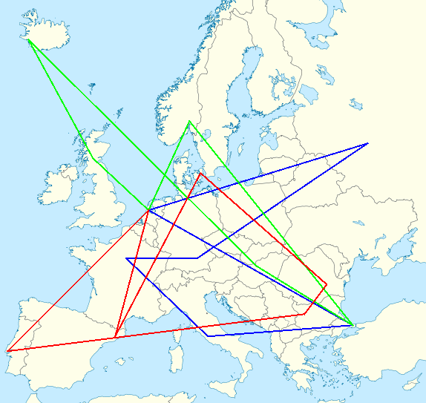
The Case
6 aircrafts
28 cities
Create one-day flight schedules
20 hour day
Boarding and refuelling times
Profit=#passengers * #kilometres
Detours

Slide 3
Random Algorithm
Create random route
Add Amsterdam if not start city
Add random city at random index if valid
Add random number of passengers if valid
Stop if no more flying time left
Store the best route

Slide 4
Random Algorithm Results
Profit: €8,837,371.00
Schedule:

Slide 5
Hill Climber Algorithm
Hill Climber
Start with resulting schedule random algorithm
Apply random mutations
Stop if no improvement for 1000 iterations
Hill Climber Restart
Local optimum → Restart with new random route

Slide 6
Mutations
Remove/add city
Add passengers
Swap cities
Swap detour

Slide 7
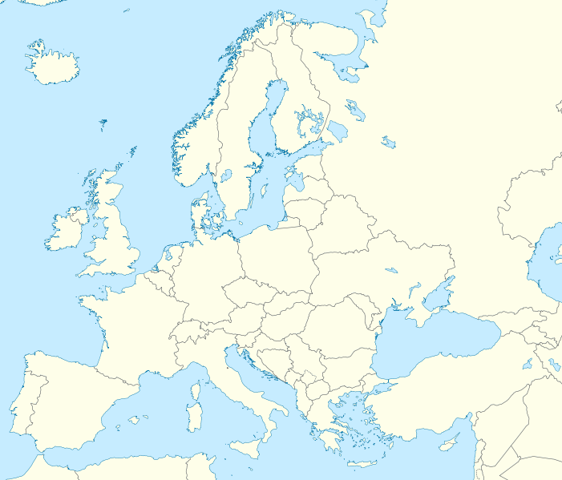
Swap detour
Old:
MAD → ATH 150
MAD → AMS 49
AMS → ATH 49
New:
MAD → ATH 49
MAD → AMS 150
AMS → ATH 150
Both cases have maximum number of passengers on the flights
In the new case passengers pay for more kilometres → higher profit

Slide 8
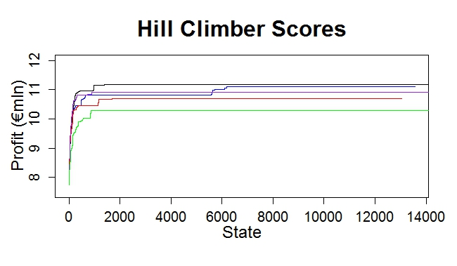
Hill Climber Results
Profit:
€11,381,637.00

Slide 9
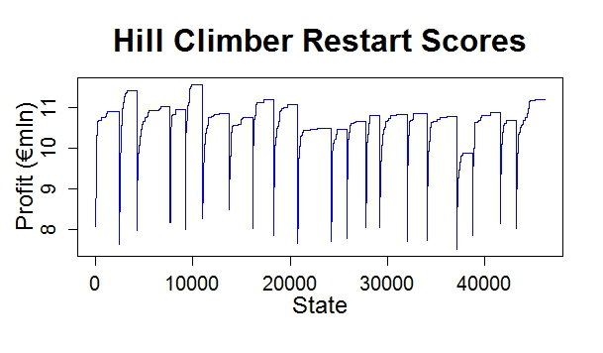
Hill Climber Restart Results
Profit:
€11,662,645.00

Slide 10
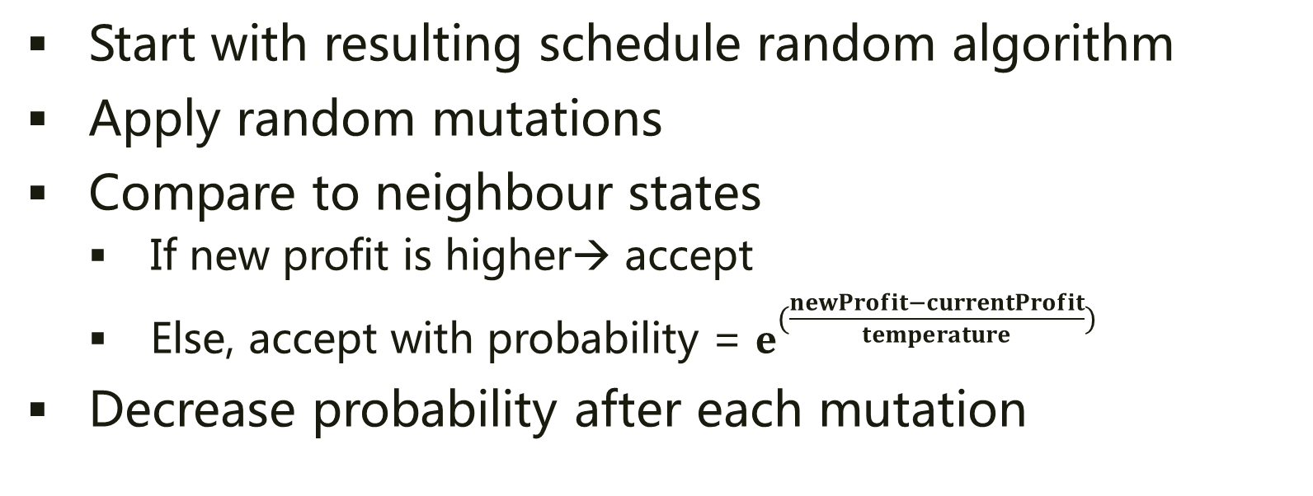
Simulated Annealing
Start with resulting schedule random algorithm
Apply random mutations
Compare to neighbour states
If new profit is higher→ accept
Else, accept with probability = $e^{(\frac{newProfit−currentProfit}{temperature})}$
Decrease probability after each mutation

Slide 11
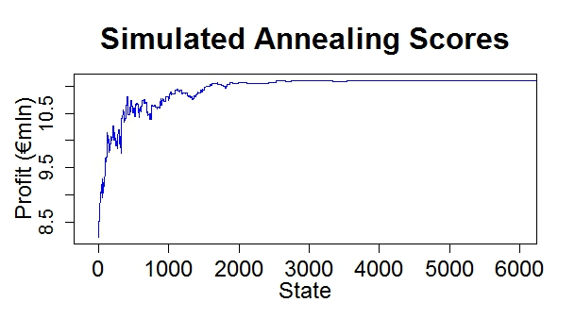
Simulated Annealing Results
Profit:
€11,381,377.00

Slide 12
Current Results
Algorithm | Profit
Random | €8,837,371.00
Hill Climber | €11,381,637.00
Hill Climber Restart | €11,662,645.00
Simulated Annealing | €11,381,377.00

Slide 13
Current Status
Parameter tuning
HomeBase Determination

